Slide 1
Cephalopod Camouflage Image Colorization Project
University of Chicago
Ping-Jung Liu
Adviser: Professor Rick Stevens

Slide 2

Motivation
https://www.youtube.com/watch?v=1VjxvrXGEHk

Slide 3
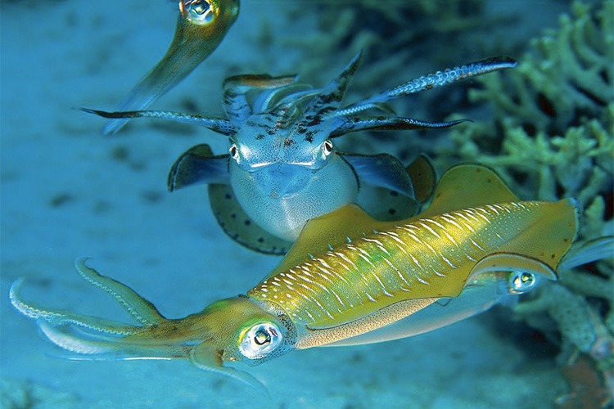
Motivation
Cephalopod Paradox - Near perfect camouflage - Color blind
Possible Explanation - U shaped pupils - Embedded colorization systems

Slide 4
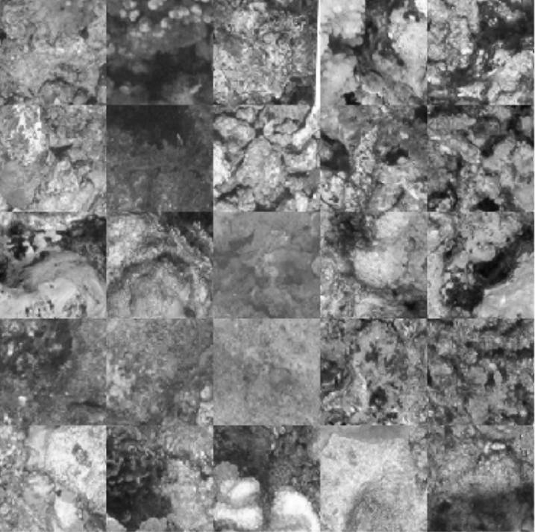
Dataset
1405 underwater natural photos, 1124 used for training
128 X 128 X 3
Converged to grayscale (from opencv.org) 0.299*red + 0.587*green + 0.114*blue

Slide 5
Base Case
Autoencoder 64 => 128 => 256 => 256 => 128 => 64
MSE + Adam
Blurry but was able to learn color patterns

Slide 6
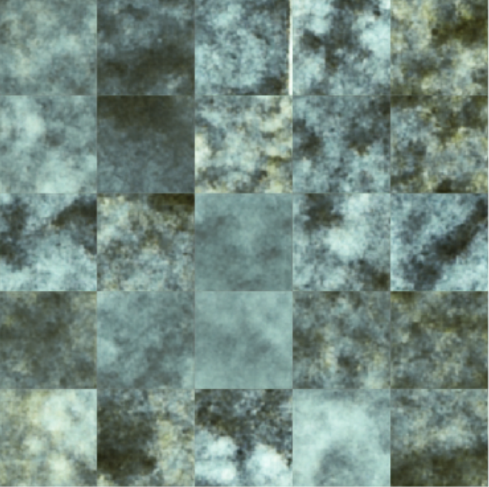
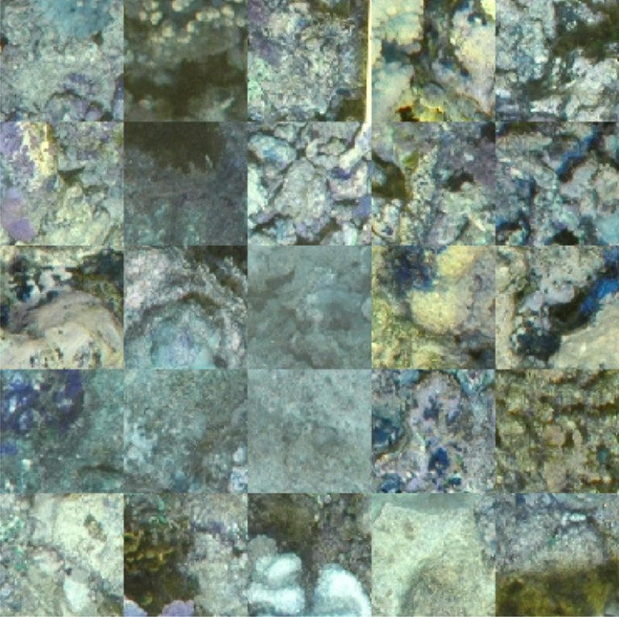
Base Case
Black/White
Autoencoder
Ground Truth

Slide 7
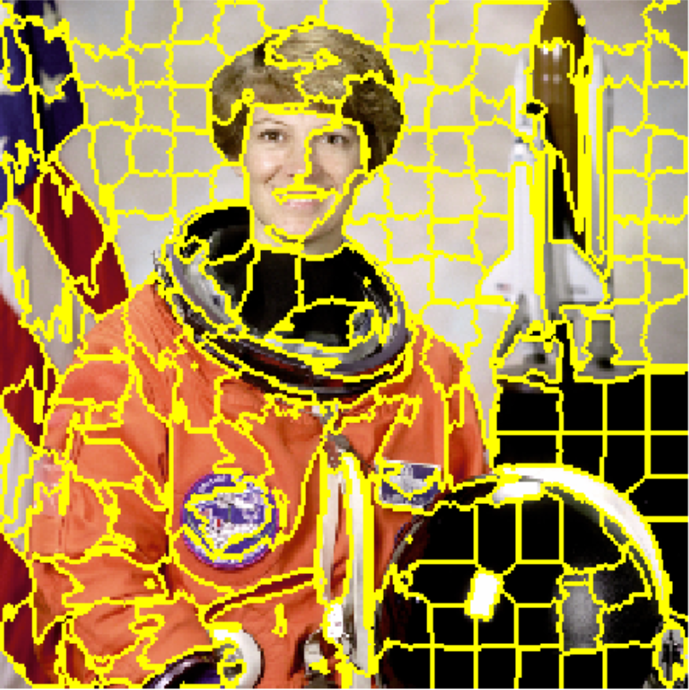
Super Pixel
Vague boundaries in base case
Felzenszwalb image segmentation
Minimum pixel per superpixel = 3
Fill in average color for each superpixel
Better boundaries, less texture

Slide 8
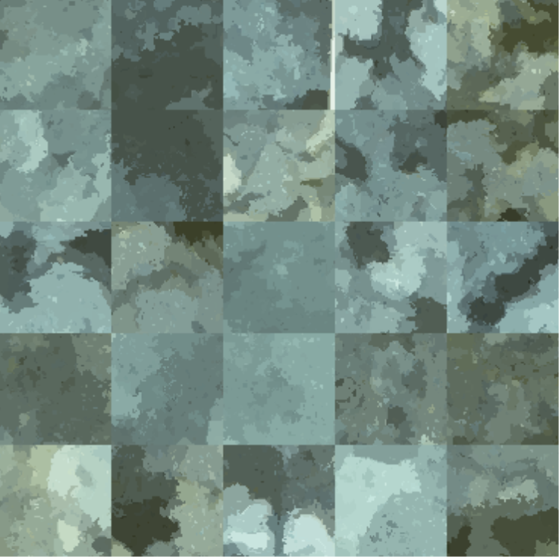
Super Pixel
Autoencoder
Super Pixel Color
Ground Truth

Slide 9
Super pixel + Luminance
Combine pure chromatic predictions from super pixel with luminance from base grayscale images
For each color pixel, scale the color channels to match original grayscale values.
Perfectly maintain texture

Slide 10
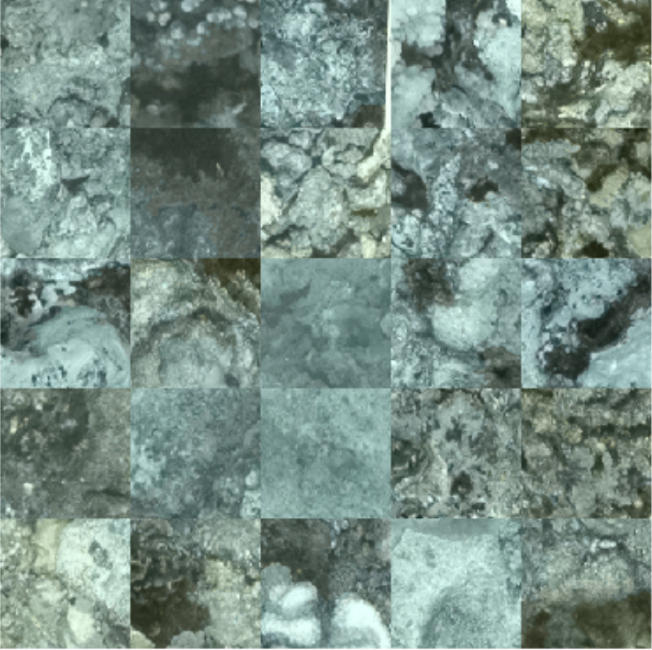
Super pixel + Luminance
Super Pixel Color
Super Pixel + Luminance
Ground Truth

Slide 11
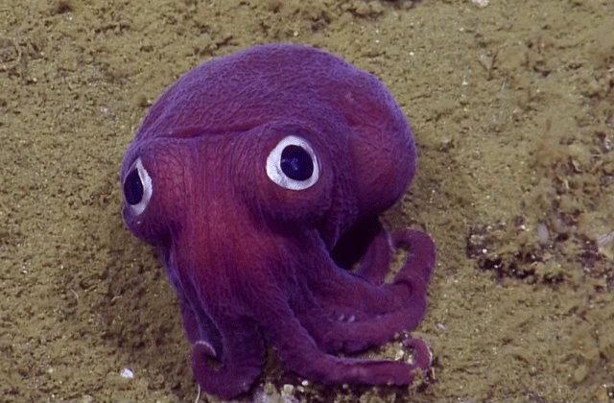
Discussion + Second half Quarter
Possible for cephalopods to add predicted color to their black/white visions
More hyperparameter optimization
Better measure for difference between images
More studies on the actual mechanisms of cephalopods’ eyes and pupils

Slide 12
Q/A

